Slide 1
Convolutional Neural Networks
Radu Ionescu, Prof. PhD.
raducu.ionescu@gmail.com
Faculty of Mathematics and Computer Science
University of Bucharest

Slide 2

Mini-batch SGD
Loop:
Sample a batch of data
Forward prop it through the graph, get loss
Backprop to calculate the gradients
Update the parameters using the gradient

Slide 3
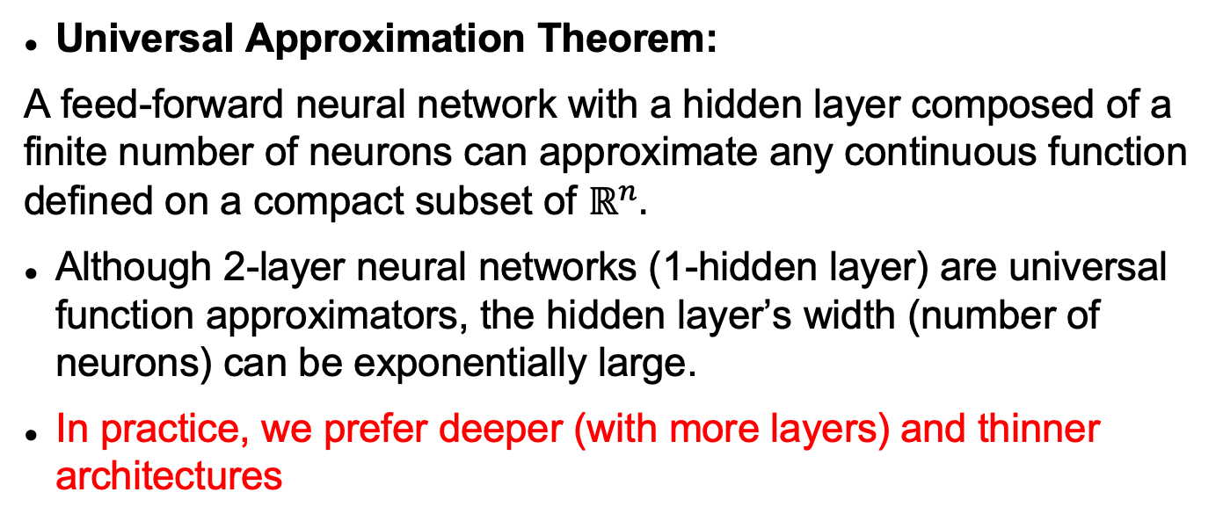
Neural networks are
universal function approximators
Universal Approximation Theorem:
A feed-forward neural network with a hidden layer composed of a finite number of neurons can approximate any continuous function defined on a compact subset of $ℝ^{n}.$
Although 2-layer neural networks (1-hidden layer) are universal function approximators, the hidden layer’s width (number of neurons) can be exponentially large.
In practice, we prefer deeper (with more layers) and thinner architectures

Slide 4
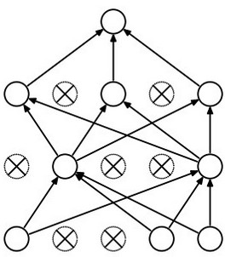
Dropout
Forces the network to have a redundant representation.
has an ear
X
has a tail
is furry
X
cat
score
has claws
X
mischievous
look

Slide 5
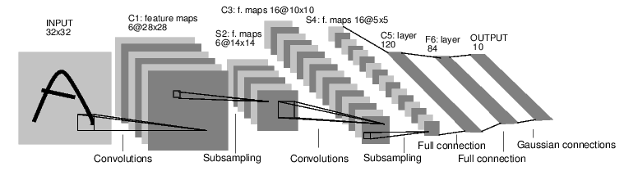
Convolutional Neural Networks
[LeNet-5, LeCun 1998]

Slide 6
Convolution Layer
Filters always extend the full depth of the input volume
32x32x3 image
5x5x3 filter
32
height
Convolve the filter with the image
i.e. “slide over the image spatially, computing dot products”
32
width
3
depth

Slide 7
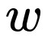
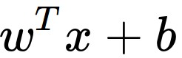
Convolution Layer
32x32x3 image
5x5x3 filter
32
1 number:
The result of taking a dot product between the filter and a small 5x5x3 chunk of the image
(i.e. 5*5*3 = 75-dimensional dot product + bias)
32
3

Slide 8
Convolution Layer
32x32x3 image
5x5x3 filter
activation map
32
28
Convolve (slide) over all spatial locations
32
28
3
1

Slide 9
Convolution Layer
32x32x3 image
5x5x3 filter
activation maps
32
28
Convolve (slide) over
all spatial locations
32
28
3
1
Consider a second, green filter

Slide 10
For example, if we had 6 5x5 filters, we’ll get 6 separate activation maps:
activation maps
32
28
Convolution Layer
32
28
3
6
We stack these up to get a “new image” of size 28x28x6!

Slide 11
Preview: A ConvNet is a sequence of Convolutional Layers, interposed with activation functions
32
28
24
….
CONV,
ReLU
e.g. 6 5x5x3 filters
CONV,
ReLU
e.g. 10 5x5x6 filters
CONV,
ReLU
32
28
24
3
6
10

Slide 12
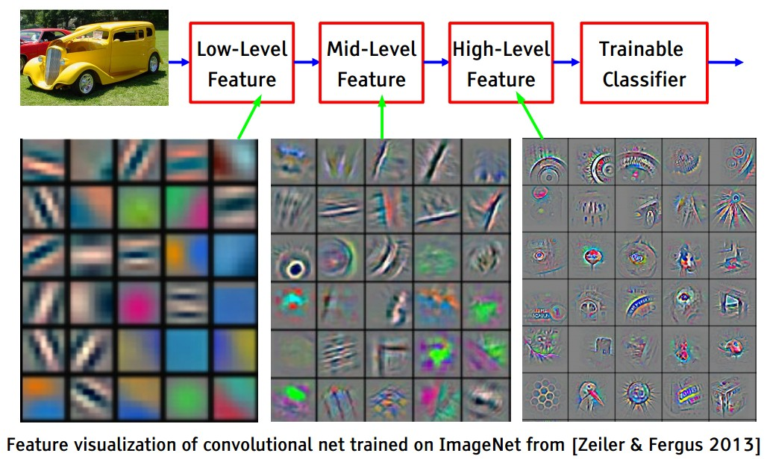
Filters correspond to features / parts of the objects
[Slide credit: Yann LeCun]

Slide 13
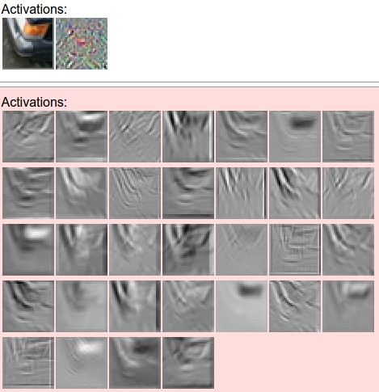

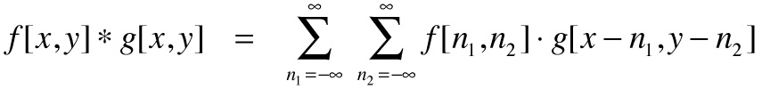
one filter =>
one activation map
example 5x5 filters
(32 total)
We call the layer convolutional because it is related to convolution of two signals:
elementwise multiplication and sum of a filter and the signal (image)

Slide 14
Maximum activation = highest response
https://commons.wikimedia.org/wiki/File:Convolution_of_box_signal_with_itself.gif

Slide 15
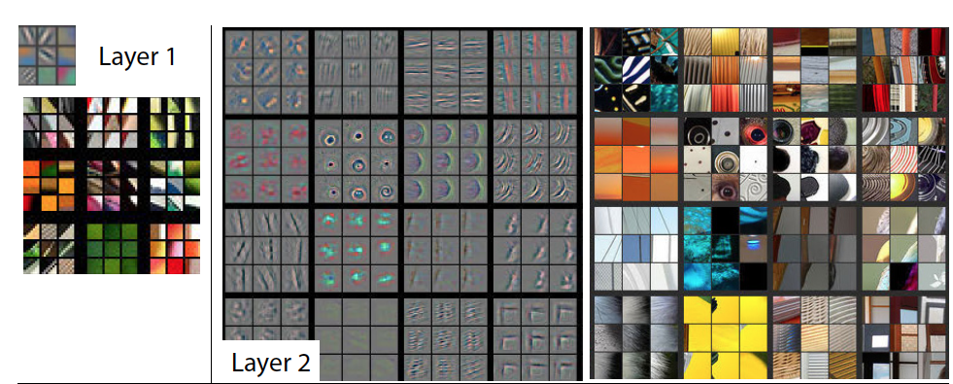
Visualizing learned filters
Figure Credit: [Zeiler & Fergus ECCV14]

Slide 16
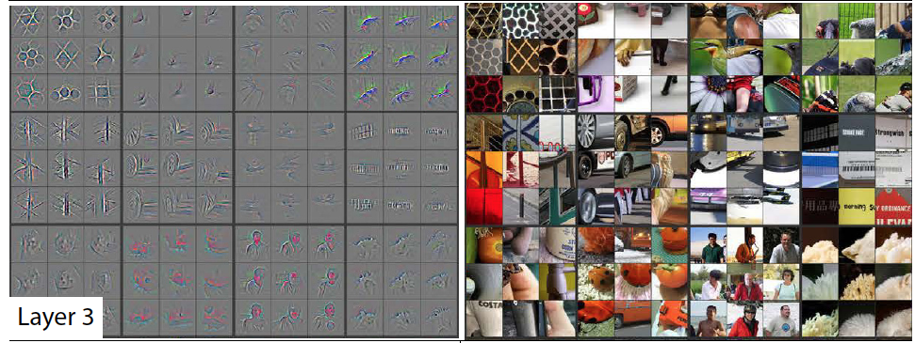
Visualizing learned filters
Figure Credit: [Zeiler & Fergus ECCV14]

Slide 17
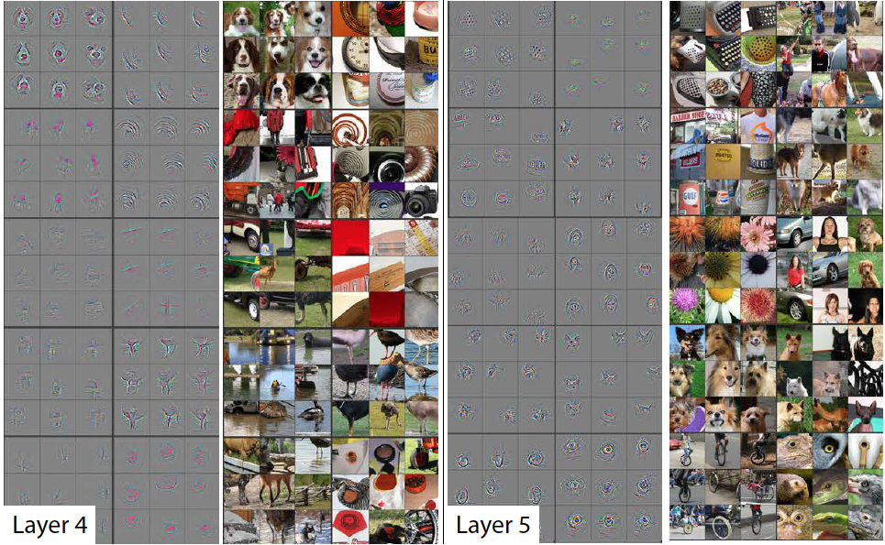
Visualizing learned filters
Figure Credit: [Zeiler & Fergus ECCV14]

Slide 18
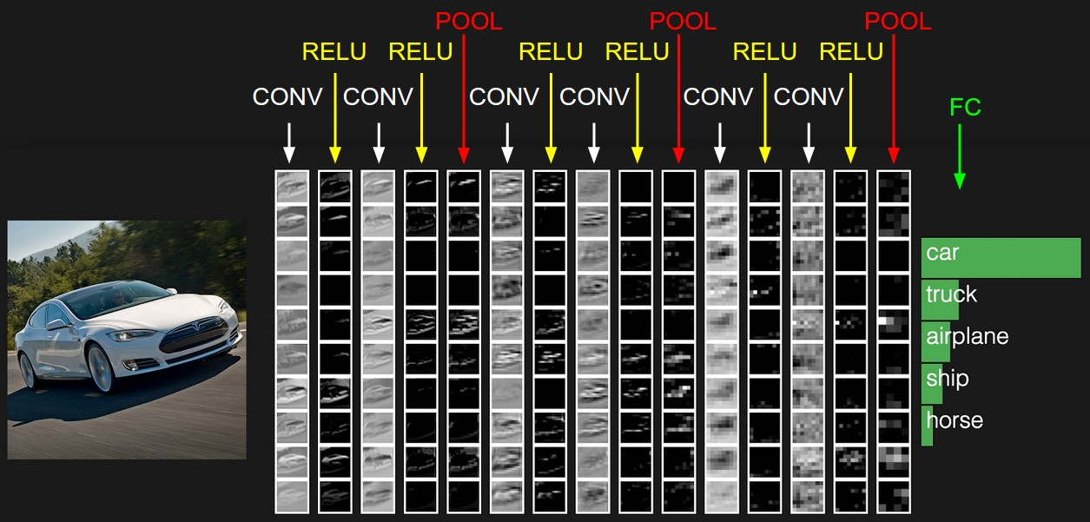

Slide 19
Size of an activation map
activation map
32x32x3 image
5x5x3 filter
32
28
Convolve (slide) over all spatial locations
32
28
3
1

Slide 20
Size of an activation map
7
7x7 input (spatially, without depth)
assume 3x3 filter
7

Slide 21
Size of an activation map
7
7x7 input (spatially, without depth)
assume 3x3 filter
7

Slide 22
Size of an activation map
7
7x7 input (spatially, without depth)
assume 3x3 filter
7

Slide 23
Size of an activation map
7
7x7 input (spatially, without depth)
assume 3x3 filter
7

Slide 24
Size of an activation map
7
7x7 input (spatially, without depth)
assume 3x3 filter
=> 5x5 output
7

Slide 25
Size of an activation map
7
7x7 input (spatially)
assume 3x3 filter
applied with stride 2
7

Slide 26
Size of an activation map
7
7x7 input (spatially)
assume 3x3 filter
applied with stride 2
7

Slide 27
Size of an activation map
7
7x7 input (spatially)
assume 3x3 filter
applied with stride 2
=> 3x3 output!
7

Slide 28
Size of an activation map
7
7x7 input (spatially)
assume 3x3 filter
applied with stride 3?
7

Slide 29
Size of an activation map
7
7x7 input (spatially)
assume 3x3 filter
applied with stride 3?
7
It does not fit!
We cannot apply a 3x3 filter on an image of 7x7 pixels using a stride of 3

Slide 30
Size of an activation map
N
Output size:
(N - F) / stride + 1
e.g. N = 7, F = 3:
stride 1 => (7 - 3)/1 + 1 = 5
stride 2 => (7 - 3)/2 + 1 = 3
stride 3 => (7 - 3)/3 + 1 = 2.33 :(
F
N
F

Slide 31
In practice: Common to zero pad the border
0 | 0 | 0 | 0 | 0 | 0
0
0
0
0
e.g. input 7x7
3x3 filter, applied with stride 1
pad with 1 pixel border => what is the output?
(recall:)
(N - F) / stride + 1

Slide 32
In practice: Common to zero pad the border
0 | 0 | 0 | 0 | 0 | 0
0
0
0
0
e.g. input 7x7
3x3 filter, applied with stride 1
pad with 1 pixel border => what is the output?
7x7 output!

Slide 33
In practice: Common to zero pad the border
0 | 0 | 0 | 0 | 0 | 0
0
0
0
0
e.g. input 7x7
3x3 filter, applied with stride 1
pad with 1 pixel border => what is the output?
7x7 output!
In general, common to see CONV layers with stride 1, filters of size FxF, and zero-padding with (F-1)/2. (preserves the size of the input image / activation map)
e.g. F = 3 => zero pad with 1 (value 0)
F = 5 => zero pad with 2 (value 0)
F = 7 => zero pad with 3 (value 0)

Slide 34
32x32 input convolved repeatedly with 5x5 filters shrinks volumes spatially!
(32 => 28 => 24 ...)
Shrinking too fast is not good, doesn’t work well.
32
28
24
….
CONV,
ReLU
e.g. 6 5x5x3 filters
CONV,
ReLU
e.g. 10 5x5x6 filters
CONV,
ReLU
32
28
24
3
6
10

Slide 35
Examples time:
Input volume: 64x64x3
20 5x5 filters with stride 1, pad 2
Output volume size: ?

Slide 36
Examples time:
Input volume: 64x64x3
20 5x5 filters with stride 1, pad 2
Output volume size:
(64+2*2-5)/1+1 = 64 spatially,
so the volume is
64x64x20

Slide 37
Examples time:
Input volume: 64x64x3
20 5x5 filters with stride 1, pad 2
Number of parameters in this layer?

Slide 38
Examples time:
Input volume: 64x64x3
20 5x5 filters with stride 1, pad 2
Number of parameters in this layer?
Each filter has 5*5*3 + 1 = 76 params (+1 for bias)
=> 76*20 = 1520

Slide 39
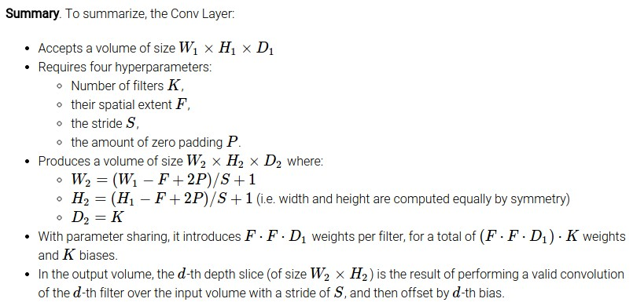
Common settings:
K = (powers of 2, e.g. 32, 64, 128, 512)
F = 3, S = 1, P = 1
F = 5, S = 1, P = 2
F = 5, S = 2, P = ? (whatever fits)
F = 1, S = 1, P = 0

Slide 40
Btw, 1x1 convolutional layers make perfect sense
1x1 CONV
with 32 filters
56
56
(each filter has size 1x1x64, and performs a 64-dimensional dot product)
56
56
64
32

Slide 41
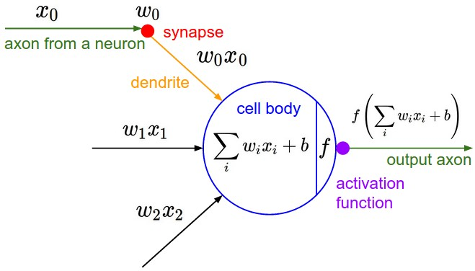
The brain/neuron view of CONV Layer
32x32x3 image
5x5x3 filter
32
It’s just a neuron with local connectivity...
1 number:
The result of taking a dot product between
the filter and this part of the image
(i.e. 5*5*3 = 75-dimensional dot product + bias)
32
3

Slide 42
The brain/neuron view of CONV Layer
32
28
An activation map is a 28x28 sheet of neuron outputs:
Each is connected to a small region in the input
All of them share parameters
5x5 filter => 5x5 receptive field for each neuron
32
28
3

Slide 43
The brain/neuron view of CONV Layer
32
28
E.g. with 5 filters,
CONV layer consists of neurons arranged in a 3D grid
(28x28x5)
There will be 5 different neurons all looking at the same region in the input volume
32
28
3
5

Slide 44
Two more layers to go: POOL/FC

Slide 45
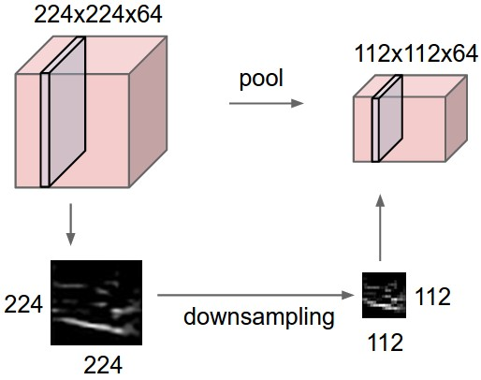
Pooling layer
Makes the representations smaller and more manageable
Operates over each activation map independently:

Slide 46
MAX Pooling
Single depth slice
1 | 1 | 2 | 4
5 | 6 | 7 | 8
3 | 2 | 1 | 0
1 | 2 | 3 | 4
x
max pool with 2x2 filters and stride 2
6 | 8
3 | 4
y

Slide 47
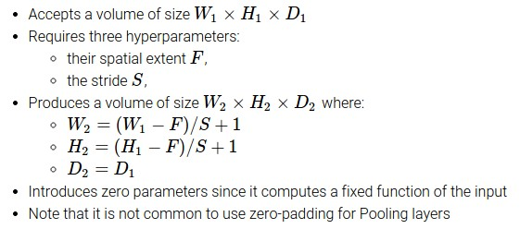
Common settings:
F = 2, S = 2
F = 3, S = 2

Slide 48
Fully-Connected Layer (FC layer)
Contains neurons that connect to the entire input volume, just as in ordinary Neural Networks

Slide 49
Case Study: LeNet-5
[LeCun et al., 1998]
Conv filters were 5x5, applied at stride 1
Subsampling (Pooling) layers were 2x2, applied at stride 2
i.e. architecture is [CONV-POOL-CONV-POOL-CONV-FC]

Slide 50
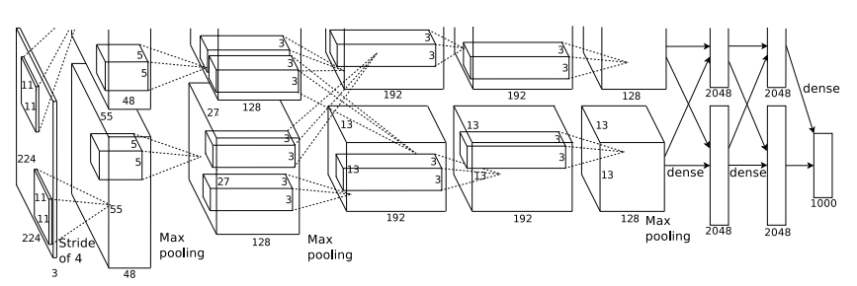
Case Study: AlexNet
[Krizhevsky et al. 2012]
Input: 227x227x3 images
First layer (CONV1): 96 11x11 filters applied at stride 4
=>
Q: What is the output volume size?
Hint: (227-11)/4+1 = 55

Slide 51
Case Study: AlexNet
[Krizhevsky et al. 2012]
Input: 227x227x3 images
First layer (CONV1): 96 11x11 filters applied at stride 4
=>
Output volume [55x55x96]
Q: What is the total number of parameters in this layer?

Slide 52
Case Study: AlexNet
[Krizhevsky et al. 2012]
Input: 227x227x3 images
First layer (CONV1): 96 11x11 filters applied at stride 4
=>
Output volume [55x55x96]
Parameters: (11*11*3)*96 = 35K

Slide 53
Case Study: AlexNet
[Krizhevsky et al. 2012]
Input: 227x227x3 images
After CONV1: 55x55x96
Second layer (POOL1): 3x3 filters applied at stride 2
Q: What is the output volume size?
Hint: (55-3)/2+1 = 27

Slide 54
Case Study: AlexNet
[Krizhevsky et al. 2012]
Input: 227x227x3 images
After CONV1: 55x55x96
Second layer (POOL1): 3x3 filters applied at stride 2
Output volume: 27x27x96
Q: What is the number of parameters in this layer?

Slide 55
Case Study: AlexNet
[Krizhevsky et al. 2012]
Input: 227x227x3 images
After CONV1: 55x55x96
Second layer (POOL1): 3x3 filters applied at stride 2
Output volume: 27x27x96
Parameters: 0

Slide 56
Case Study: AlexNet
[Krizhevsky et al. 2012]
Input: 227x227x3 images
After CONV1: 55x55x96
After POOL1: 27x27x96
...

Slide 57
Case Study: AlexNet
[Krizhevsky et al. 2012]
Full (simplified) AlexNet architecture:
[227x227x3] INPUT
[55x55x96] CONV1: 96 11x11 filters at stride 4, pad 0
[27x27x96] MAX POOL1: 3x3 filters at stride 2
[27x27x96] NORM1: Normalization layer
[27x27x256] CONV2: 256 5x5 filters at stride 1, pad 2
[13x13x256] MAX POOL2: 3x3 filters at stride 2
[13x13x256] NORM2: Normalization layer
[13x13x384] CONV3: 384 3x3 filters at stride 1, pad 1
[13x13x384] CONV4: 384 3x3 filters at stride 1, pad 1
[13x13x256] CONV5: 256 3x3 filters at stride 1, pad 1
[6x6x256] MAX POOL3: 3x3 filters at stride 2
[4096] FC6: 4096 neurons
[4096] FC7: 4096 neurons
[1000] FC8: 1000 neurons (class scores)
Details/Retrospectives:
- First use of ReLU
- Used Norm layers (not common anymore)
- Heavy data augmentation
- Dropout 0.5
- Batch size 128
- SGD Momentum 0.9
- Learning rate 1e-2, reduced by 10
manually when validation accuracy plateaus
- L2 weight decay 5e-4
- 7 CNN ensemble: 18.2% -> 16.4%

Slide 58
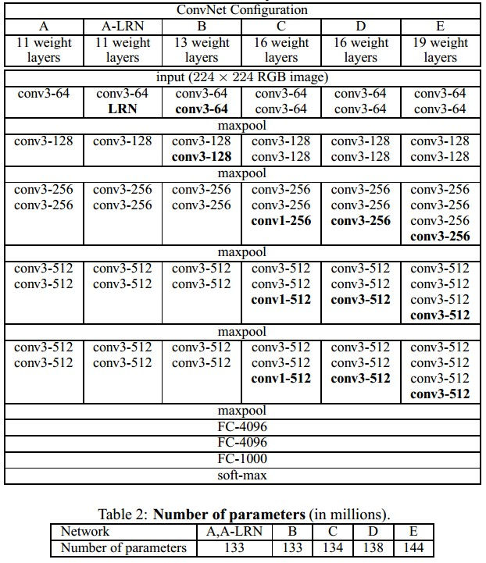
Case Study: VGGNet
[Simonyan and Zisserman, 2014]
Only 3x3 CONV stride 1, pad 1
and 2x2 MAX POOL stride 2
Best model
11.2% top 5 error in ILSVRC 2013
=>
7.3% top 5 error

Slide 59
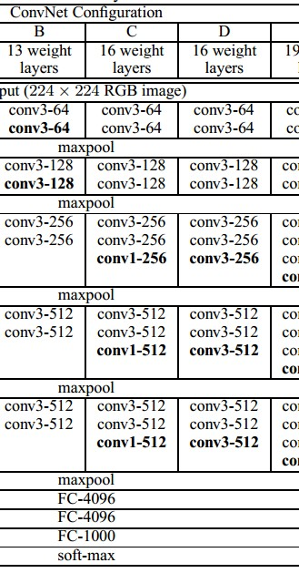
(not counting biases)
INPUT: [224x224x3] memory: 224*224*3=150K params: 0
CONV3-64: [224x224x64] memory: 224*224*64=3.2M params: (3*3*3)*64 = 1,728
CONV3-64: [224x224x64] memory: 224*224*64=3.2M params: (3*3*64)*64 = 36,864
POOL2: [112x112x64] memory: 112*112*64=800K params: 0
CONV3-128: [112x112x128] memory: 112*112*128=1.6M params: (3*3*64)*128 = 73,728
CONV3-128: [112x112x128] memory: 112*112*128=1.6M params: (3*3*128)*128 = 147,456
POOL2: [56x56x128] memory: 56*56*128=400K params: 0
CONV3-256: [56x56x256] memory: 56*56*256=800K params: (3*3*128)*256 = 294,912
CONV3-256: [56x56x256] memory: 56*56*256=800K params: (3*3*256)*256 = 589,824
CONV3-256: [56x56x256] memory: 56*56*256=800K params: (3*3*256)*256 = 589,824
POOL2: [28x28x256] memory: 28*28*256=200K params: 0
CONV3-512: [28x28x512] memory: 28*28*512=400K params: (3*3*256)*512 = 1,179,648
CONV3-512: [28x28x512] memory: 28*28*512=400K params: (3*3*512)*512 = 2,359,296
CONV3-512: [28x28x512] memory: 28*28*512=400K params: (3*3*512)*512 = 2,359,296
POOL2: [14x14x512] memory: 14*14*512=100K params: 0
CONV3-512: [14x14x512] memory: 14*14*512=100K params: (3*3*512)*512 = 2,359,296
CONV3-512: [14x14x512] memory: 14*14*512=100K params: (3*3*512)*512 = 2,359,296
CONV3-512: [14x14x512] memory: 14*14*512=100K params: (3*3*512)*512 = 2,359,296
POOL2: [7x7x512] memory: 7*7*512=25K params: 0
FC: [1x1x4096] memory: 4096 params: 7*7*512*4096 = 102,760,448
FC: [1x1x4096] memory: 4096 params: 4096*4096 = 16,777,216
FC: [1x1x1000] memory: 1000 params: 4096*1000 = 4,096,000
TOTAL memory: 24M * 4 bytes ~= 93MB / image (only forward! ~x2 for backward)
TOTAL params: 138M parameters

Slide 60
(not counting biases)
INPUT: [224x224x3] memory: 224*224*3=150K params: 0
CONV3-64: [224x224x64] memory: 224*224*64=3.2M params: (3*3*3)*64 = 1,728
CONV3-64: [224x224x64] memory: 224*224*64=3.2M params: (3*3*64)*64 = 36,864
POOL2: [112x112x64] memory: 112*112*64=800K params: 0
CONV3-128: [112x112x128] memory: 112*112*128=1.6M params: (3*3*64)*128 = 73,728
CONV3-128: [112x112x128] memory: 112*112*128=1.6M params: (3*3*128)*128 = 147,456
POOL2: [56x56x128] memory: 56*56*128=400K params: 0
CONV3-256: [56x56x256] memory: 56*56*256=800K params: (3*3*128)*256 = 294,912
CONV3-256: [56x56x256] memory: 56*56*256=800K params: (3*3*256)*256 = 589,824
CONV3-256: [56x56x256] memory: 56*56*256=800K params: (3*3*256)*256 = 589,824
POOL2: [28x28x256] memory: 28*28*256=200K params: 0
CONV3-512: [28x28x512] memory: 28*28*512=400K params: (3*3*256)*512 = 1,179,648
CONV3-512: [28x28x512] memory: 28*28*512=400K params: (3*3*512)*512 = 2,359,296
CONV3-512: [28x28x512] memory: 28*28*512=400K params: (3*3*512)*512 = 2,359,296
POOL2: [14x14x512] memory: 14*14*512=100K params: 0
CONV3-512: [14x14x512] memory: 14*14*512=100K params: (3*3*512)*512 = 2,359,296
CONV3-512: [14x14x512] memory: 14*14*512=100K params: (3*3*512)*512 = 2,359,296
CONV3-512: [14x14x512] memory: 14*14*512=100K params: (3*3*512)*512 = 2,359,296
POOL2: [7x7x512] memory: 7*7*512=25K params: 0
FC: [1x1x4096] memory: 4096 params: 7*7*512*4096 = 102,760,448
FC: [1x1x4096] memory: 4096 params: 4096*4096 = 16,777,216
FC: [1x1x1000] memory: 1000 params: 4096*1000 = 4,096,000
Note:
Most memory is in early CONV
Most params are
in late FC
TOTAL memory: 24M * 4 bytes ~= 93MB / image (only forward! ~x2 for backward)
TOTAL params: 138M parameters

Slide 61
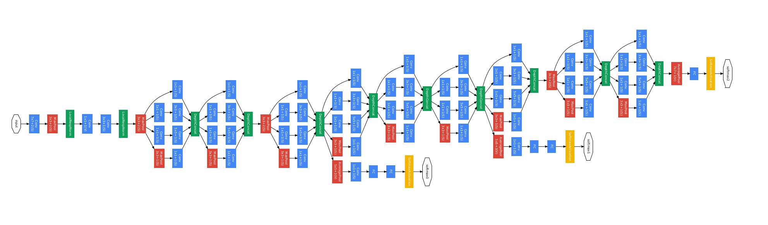
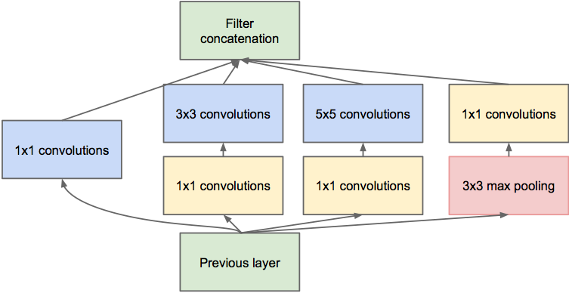
Case Study: GoogLeNet
[Szegedy et al., 2014]
Inception module
ILSVRC 2014 winner (6.7% top 5 error)

Slide 62
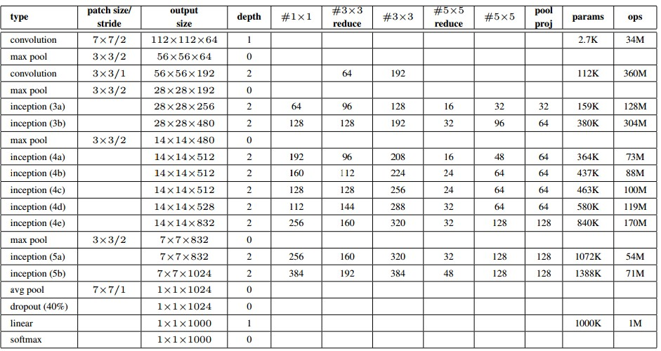
Case Study: GoogLeNet
Fun features:
- Only 5 million params!
(Removes FC layers completely)
Compared to AlexNet:
- 12x less params
- 2x more computations
- 6.67% (vs. 16.4%)

Slide 63
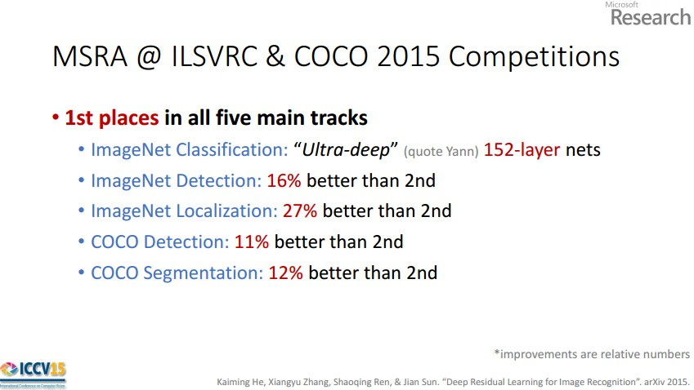
Case Study: ResNet
[He et al., 2015]
ILSVRC 2015 winner (3.6% top 5 error)
Slide after Kaiming He

Slide 64
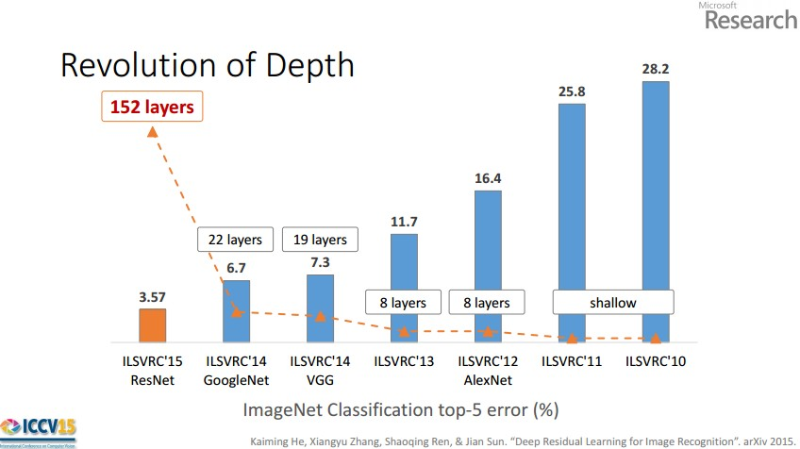
Slide after Kaiming He

Slide 65
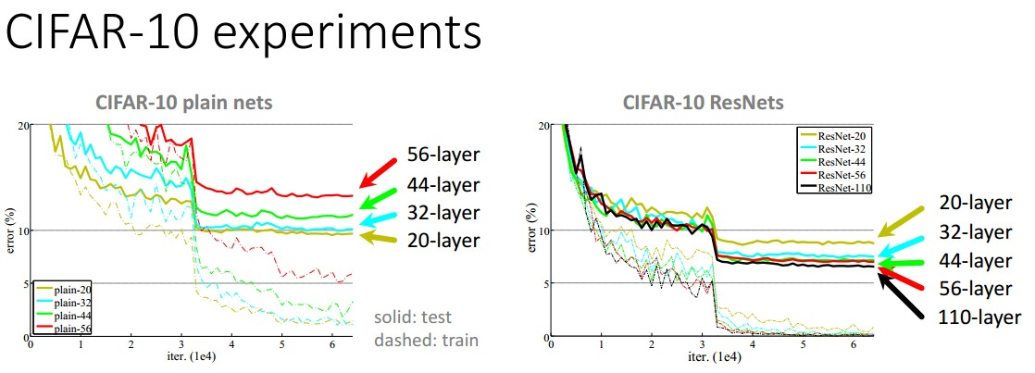
Slide after Kaiming He

Slide 66
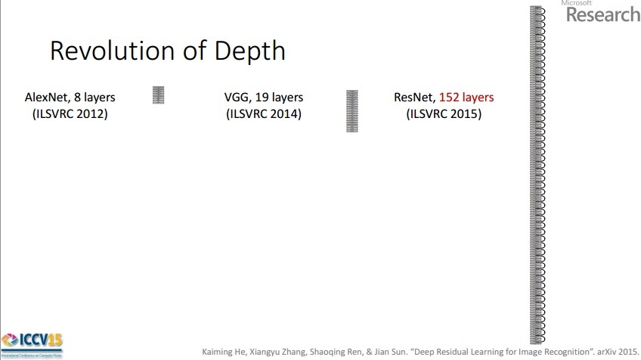
Case Study: ResNet
[He et al., 2015]
ILSVRC 2015 winner (3.6% top 5 error)
2-3 weeks of training on 8 GPU machine
at runtime: faster than a VGGNet! (even though it has 8x more layers)
Slide after Kaiming He

Slide 67
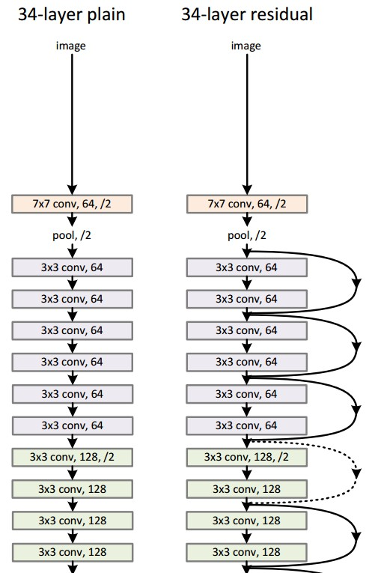
Case Study: ResNet
[He et al., 2015]
224x224x3
Spatial dimension only 56x56!

Slide 68
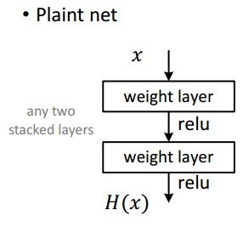
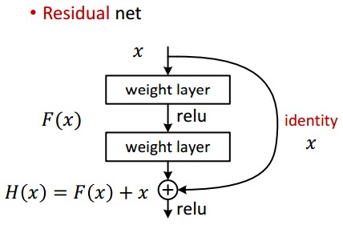
Case Study: ResNet
[He et al., 2015]

Slide 69
Case Study: ResNet
[He et al., 2015]
Batch Normalization after every CONV layer
Xavier/2 initialization
SGD + momentum (0.9)
Learning rate: 0.1, divided by 10 when validation error plateaus
Mini-batch size 256
Weight decay of 1e-5
No dropout used!

Slide 70
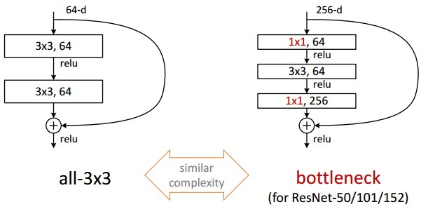
Case Study: ResNet
[He et al., 2015]

Slide 71
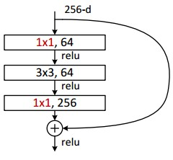
Case Study: ResNet
[He et al., 2015]
This trick is also used in GoogLeNet

Slide 72
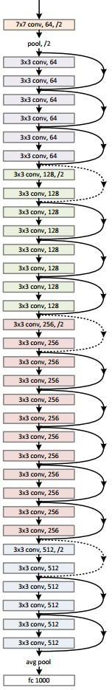
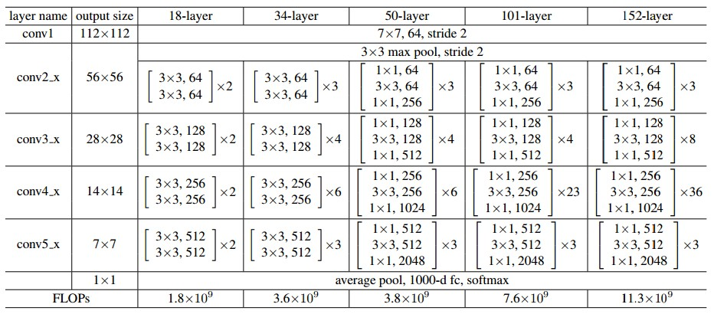
Case Study: ResNet
[He et al., 2015]

Slide 73
Summary
ConvNets stack CONV, POOL, FC layers
Trend towards smaller filters and deeper architectures
Trend towards getting rid of POOL/FC layers (just CONV)
Typical architectures look like
[(CONV-RELU)*N-POOL?]*M-(FC-RELU)*K,SOFTMAX
where N is usually up to ~5, M is large, 0 <= K <= 2.
… but recent advances such as ResNet/GoogLeNet challenge this paradigm

